Slide 1
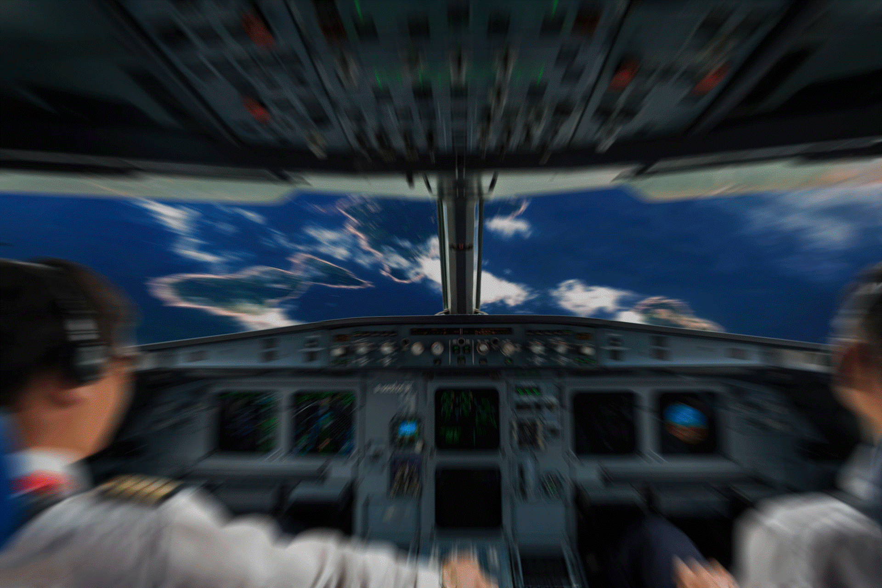
“Artificial Intelligence and Cyber Security in Civil and Military Aviation”
The Cyber Security factor in the implementation of AI in transportation
Dr. Dimitrios Ziakkas
Purdue University, USA
30 May 2024

Slide 2

What to ecpect…
Introduction
Recent Studies
Ongoing Studies
Feedback

Slide 3
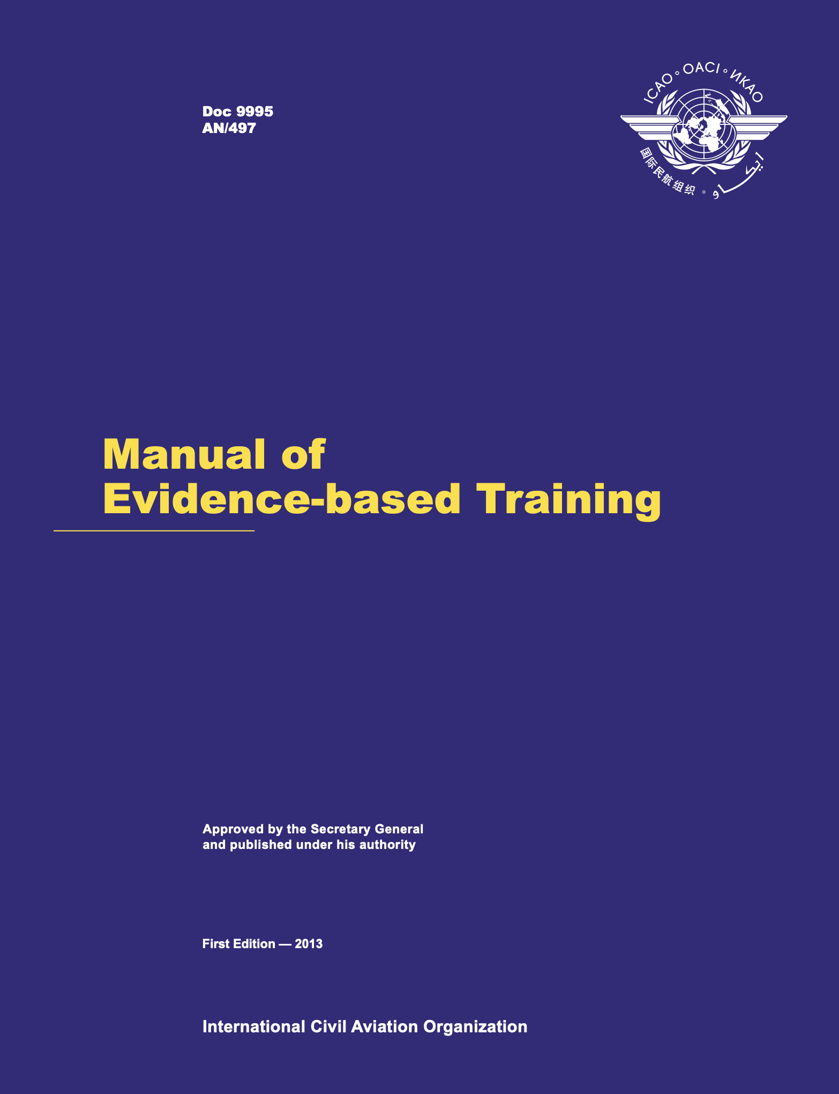
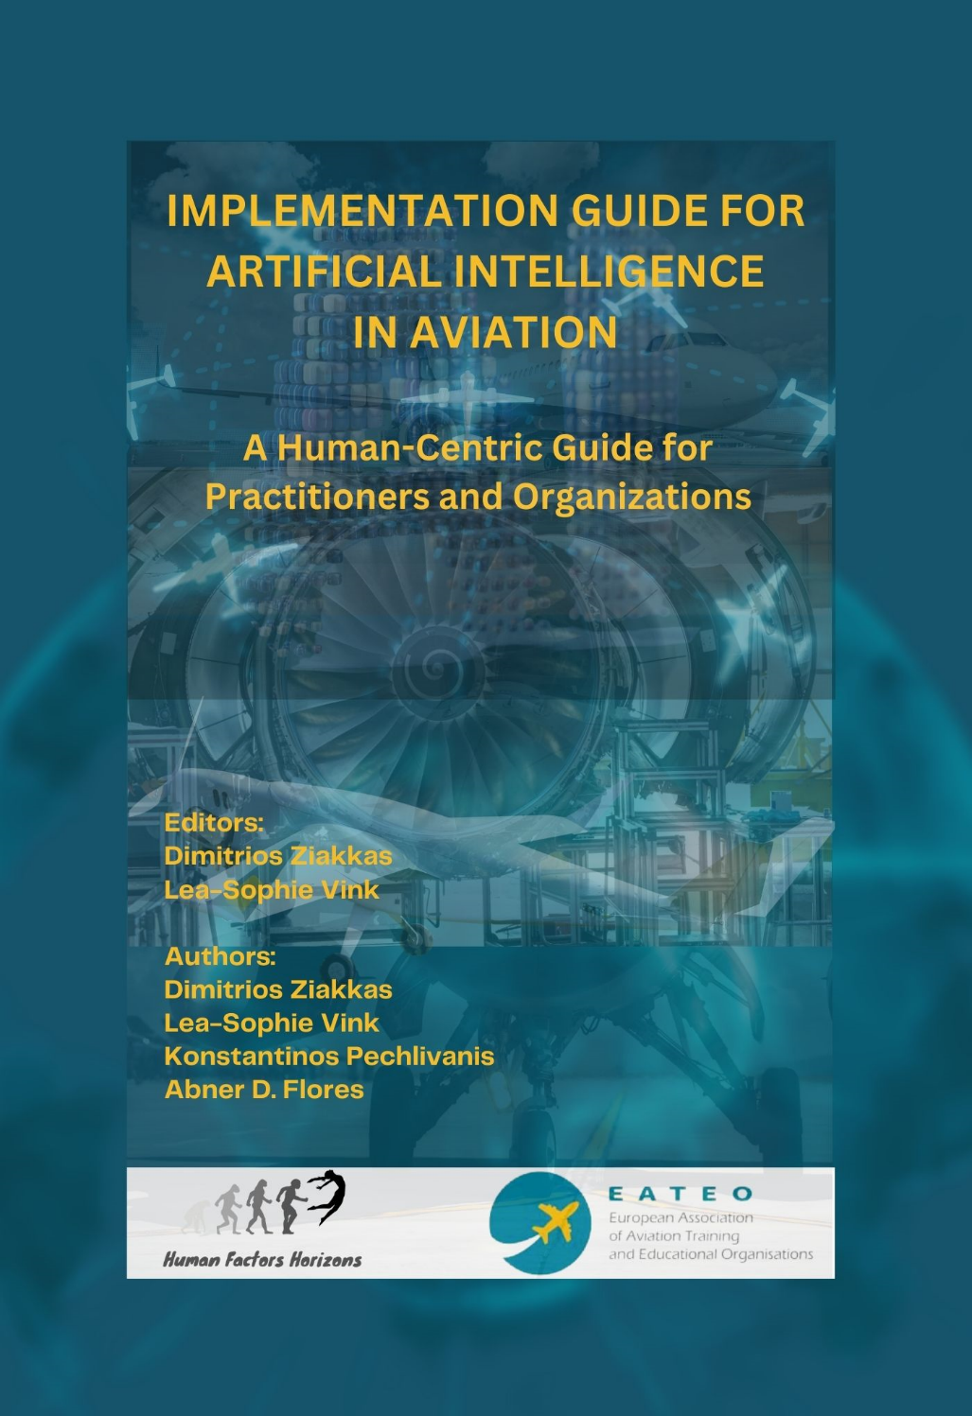
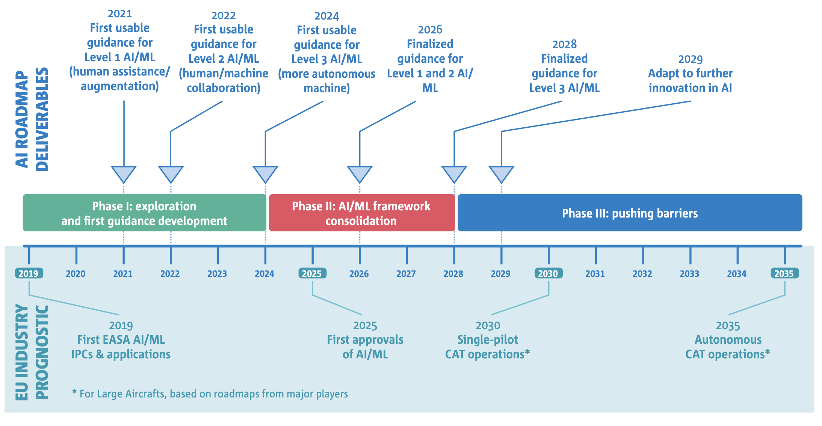
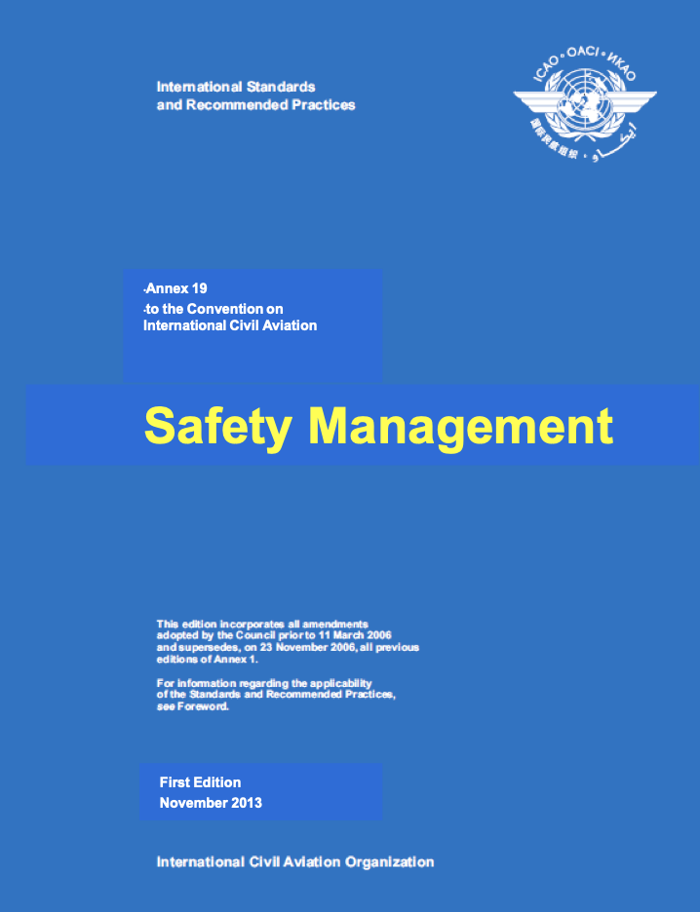
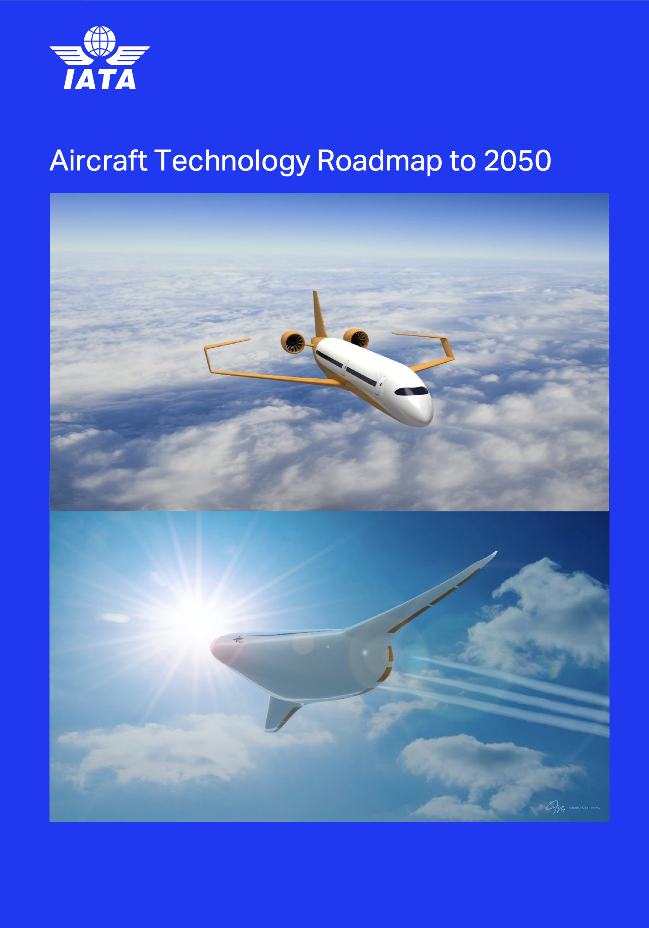
Introduction
Notes:
Competency-Based Training and Assessment (CBTA) is a method that proposes an assessment process that helps understand how a flight crew may be able to manage both foreseen and unforeseen incidents and uses this data to help the crew achieve a higher level of efficiency. Each training program must be effectively integrated to ensure contextualization and relevance to achieve this objective.
This synthesis of EBT–CBTA and SMS enhances performance of individual learners or groups and the effectiveness of the content being utilized.
Artificial Intelligence (AI) is revolutionizing the aviation industry, particularly in-flight training and operations. Pilots increasingly use interactive learning methods like virtual reality (VR) for cockpit procedural training, saving airlines and operators thousands of euros by replacing fixed-base simulators. AI-powered flight simulators train pilots in various scenarios, including abnormal operations, emergencies, and adverse weather conditions. Innovative technologies like VR training combined with biometric data like eye-tracking and facial tracking can be a powerful platform for obtaining the required dataset. By training pilots in a virtual environment, instructors introduce evidence-based scenarios testing their performance while collecting the required data.

Slide 4
Recent Studies - Why Measure Fatigue?
Recent Studies - Why Measure AI –Cybersecurity Awareness?

Slide 5
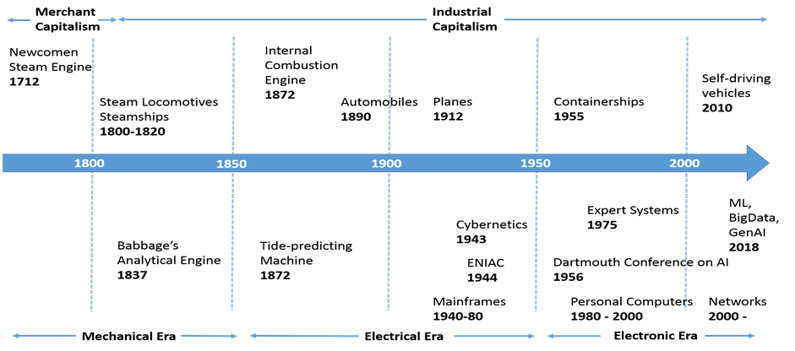
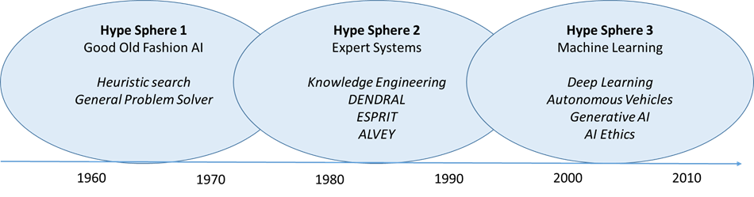
Recent Studies - Why Measure AI – Cybersecurity Awareness?
Konstantinos Sakalis

Slide 6


Recent Studies - Why Measure AI –Cybersecurity?
Several definitions of the construct exist:
Several of them are found outside of academia, mostly in documents published by regulatory bodies (ICAO, National Civil Aviation Authorities, trade unions like IATA and others).
A typical definition states:
Aviation cyber security may be considered as the convergence of people, processes, and technology that come together to
Protect civil aviation organizations, operations, and passengers from digital attacks.
(IATA, 2020)
The uni-dimensional or multi-dimensional nature of the construct is debated.
Most research seems to suggest that AI -Cybersecurity is multidimensional in nature, with at least two distinct components:
AI
Cybersecurity

Slide 7
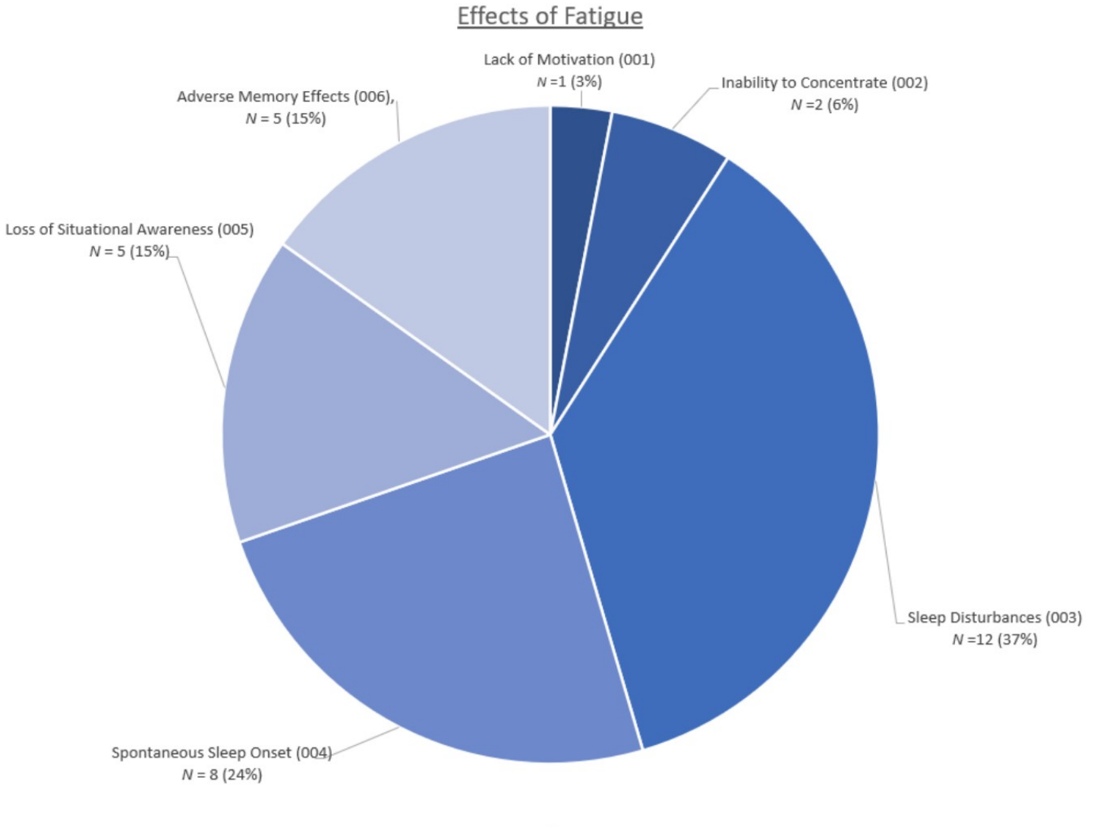
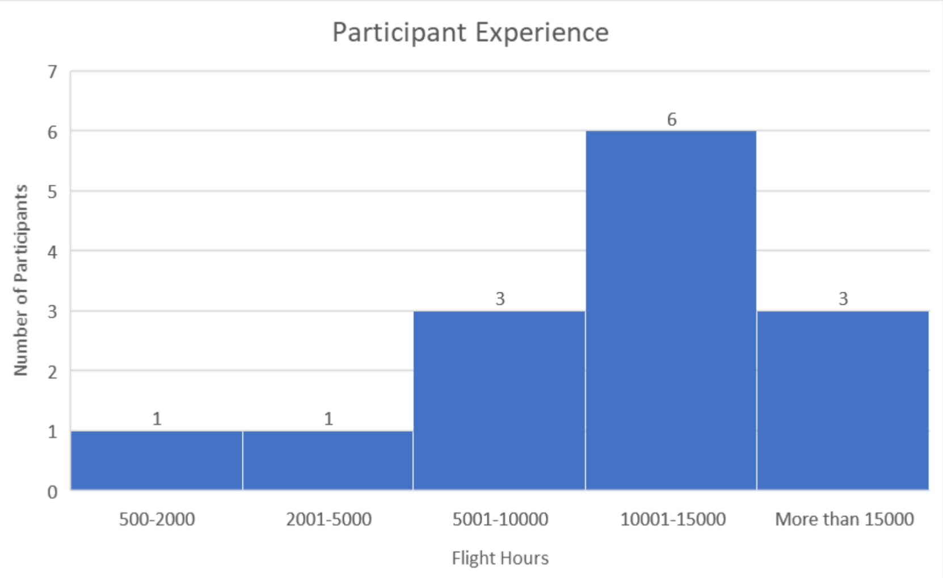
Study Design and Methods
Literature Review
Qualitative Phase
Quantitative Phase
A review of current research on AI in transportation with special focus on the uni /multi-dimensional nature of the construct, and current practice on measuring AI awareness, as well as the implementation AI Risk Management in airline operations with particular focus on Cybersecurity TEM
Fifteen Subject Matter Experts participated in semi structured interviews.
Information acquired during this phase was used to inform the development of prototype AI / Cybersecurity survey and self report instruments for the subsequent quantitative phase.
Eighty-six experienced aviation professionals participated in an internet-mediated survey. Statistical analysis was performed on the data collected and the validity of the hypothesis was evaluated. The reliability and validity of the survey instrument was assessed using appropriate statistical methods.

Slide 8
Recent Studies - Why Measure AI-Cybersecurity Awareness?

Slide 9


Slide 10


Results suggest that current generation airline AI - Cybersecurity implementation management instruments are inadequate for a comprehensive assessment of aircrew AI –Cybersecurity Awareness levels, since they are not sensitive to significant components of the construct (AI Levels - Cybersecurity).

Slide 11
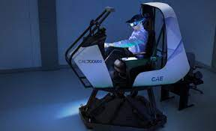
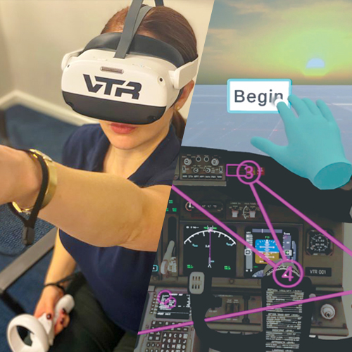
Recent Studies - Why Measure Fatigue?
Overview of AI in Biometric Analysis
AI and machine learning offer transformative potential in interpreting biometric data. By leveraging complex algorithms, AI can uncover subtle patterns and insights from physiological and behavioral data that might be imperceptible to human analysts.
Data Processing and Pattern Recognition
AI excels in processing and analyzing large volumes of data rapidly. In the context of biometrics, AI algorithms can discern patterns correlating with fatigue, stress, or other psychological states. For instance, AI can analyze eye-tracking data to detect microsleeps or patterns indicative of decreased vigilance, providing early warnings of fatigue.
Predictive Analytics
Predictive analytics is a powerful application of AI, using historical and real-time data to forecast future events. In aviation, AI can analyze trends in a pilot's biometric data to predict potential fatigue or stress before it becomes critical, thereby enhancing safety measures. Predictive models can suggest proactive interventions, like advising rest periods or providing cognitive support.
Real-time Monitoring and Decision Support
Integrating AI with real-time monitoring systems allows for immediate interpretation of biometric data, facilitating timely decision-making. For example, AI can analyze data from wearable devices to provide cockpit alerts or recommendations, helping pilots manage their cognitive load and maintain optimal performance levels.

Slide 12
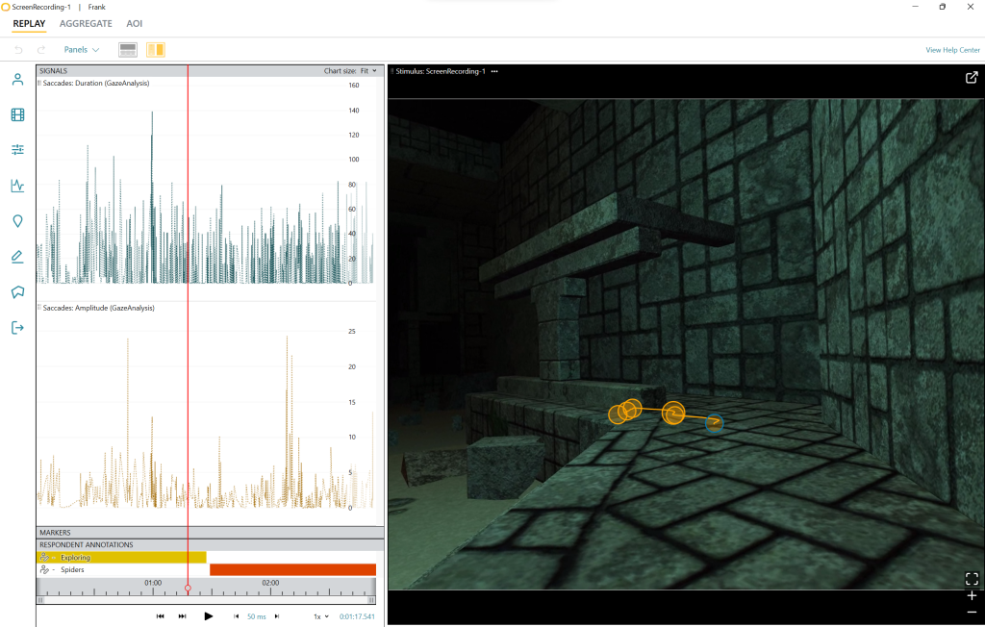
Recent Studies - Why Measure Fatigue?
Expand on Biometric Technologies in Aviation
Eye Tracking: This technology measures eye movements, blink rate, and pupil dilation. For instance, the XXX eye-tracking VR headset can detect microsleeps (brief lapses in attention), which are critical indicators of fatigue. Such technology helps in assessing a pilot's alertness and cognitive workload.
Heart Rate Variability (HRV): HRV monitoring, like that offered by devices from YYY or ZZZ, can indicate stress levels or mental overload, which are often precursors to fatigue. These wearables provide real-time data, enabling timely interventions.
EEG (Electroencephalogram): EEG headsets, such as those developed by KKK, can monitor brain waves. This technology can detect changes in cognitive states, providing insights into a pilot's focus, stress levels, and fatigue.

Slide 13

Recent Studies - Why Measure Fatigue?
Expand on Biometric Technologies in Aviation
Application of Biometrics to Monitor Fatigue
Biometric measures are sensitive to the subtle changes associated with fatigue. For instance, eye tracking can reveal decreased blink rates or prolonged closure, which are indicators of fatigue. Similarly, heart rate variability can reflect changes in the autonomous nervous system associated with stress or tiredness.
Challenges and Limitations
Despite the potential, integrating biometrics into routine aviation operations comes with challenges. The accuracy and reliability of data, integration with existing systems, and ensuring the privacy and security of sensitive biometric data are significant concerns.

Slide 14
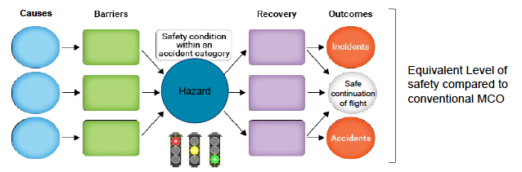
Recent Studies - Why Measure Fatigue?
Aspects of AI - Cybersecurity:
AI – Mental state
Acute Stress
Emotion
Decision Making: AI can assist pilots in multiple failures providing validated real time options
Attention and Vigilance: Biometrics can prevent mental state issues – pilot incapacitation and cybersecurity threats.
Stress and Emotional Regulation: The demands of managing complex systems and decision-making under stress can exacerbate fatigue.
Pilots under fatigue or stress may have a reduced capacity for managing emotions, potentially leading to overreaction or disengagement in critical situations.

Slide 15

Recent Studies - Why Measure Fatigue?
Machine Learning for Predictive Analytics in Health Monitoring
Machine Learning for Predictive Analytics in Health Monitoring
Example: Heart Rate Variability (HRV) for Stress and Workload Management
  Technology: Support Vector Machines (SVM) or Random Forest algorithms.
  Application: Wearable devices equipped with HRV sensors can collect data on pilots' physiological responses. AI algorithms analyze this data to detect patterns associated with stress or excessive workload. For instance, Garmin and Polar devices are used to monitor HRV, offering insights into the autonomic nervous system's activity.
  Impact: Assisting in managing pilots' workloads and stress levels, potentially reducing the risk of error due to cognitive overload or fatigue.

Slide 16
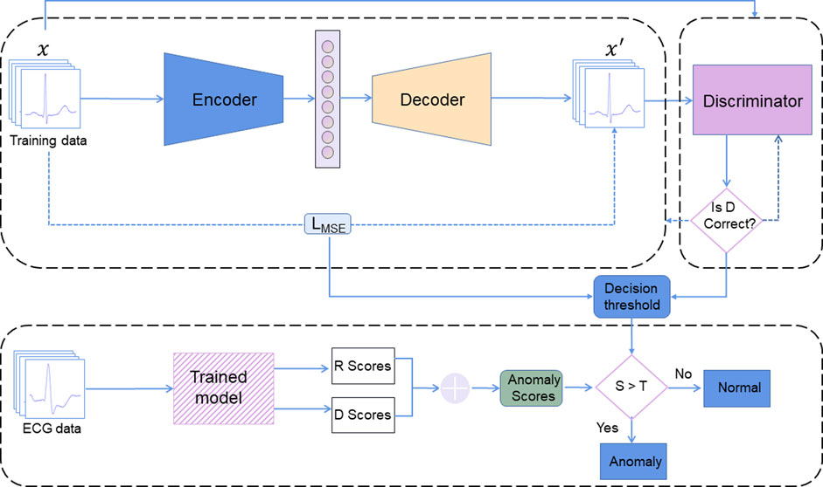
Recent Studies - Why Measure Fatigue?
Deep Learning for Anomaly Detection in Physiological Data
Example: EEG for Cognitive State Monitoring
  Technology: Recurrent Neural Networks (RNN) or Long Short-Term Memory (LSTM) networks.
  Application: Devices like the KKK EEG headset can monitor brainwave patterns. AI algorithms analyze these patterns to detect anomalies or changes that may indicate fatigue, decreased attention, or other cognitive states that could impact pilot performance.
  Impact: Providing insights into pilots' cognitive workload and mental state, facilitating interventions to maintain optimal cognitive function during flights.

Slide 17
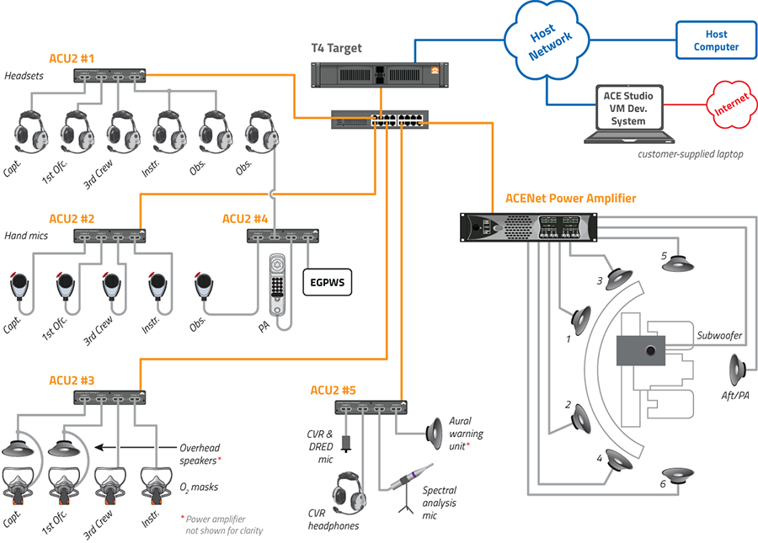
Recent Studies - Why Measure Fatigue?
Natural Language Processing (NLP) for Stress Detection in Communication
Simulated Air Traffic Control Environment
Example: Voice Analysis for Stress and Emotional State Assessment
  Technology: NLP and sentiment analysis algorithms.
  Application: Analyzing communication between pilots and air traffic control to detect signs of stress or confusion in voice patterns. Technologies developed by companies like IBM or Nuance Communications can assess tone, pitch, and speech rate to provide insights into the speaker's emotional state.
  Impact: Enhancing situational awareness and ensuring effective communication, crucial for maintaining safety standards in high-stress environments.

Slide 18

On- going Challenges
Our research focuses on the following key aspects and applications :
Enhanced scenario-based training
Improved situational awareness
Emergency/abnormal situations communication and procedures training in Cybersecurity threats
Radio discipline: phraseology and communication protocols
Multi-aircraft scenarios for practicing communication and coordination
ATC center, approach/departure, and tower control training
Scalable training
Training data analysis and performance feedback

Slide 19

- Why Measure AI-Cybersecurity?
Develop and implement a comprehensive program focusing on transportation cyber resilience principles and practices, tailored for online delivery.
Participants will engage in simulated cyber attack scenarios relevant to transportation systems, utilizing our secure online environment.
Throughout the training, we'll provide virtual training materials, resources, and expert guidance to support participants in understanding and addressing cybersecurity challenges specific to the transportation sector.
Networking opportunities will be facilitated through online forums, webinars, and virtual meet-ups, enabling collaboration and knowledge exchange among participants, industry professionals, mentors, and peers. Evaluating and recognizing innovative solutions and exemplary performances will remain a priority, fostering excellence and continuous improvement in transportation cyber resilience strategies.
Collaborating with industry partners and stakeholders (EATEO), we’ll ensure the training objectives and outcomes are relevant and applicable within the evolving landscape of online transportation cybersecurity.

Slide 20

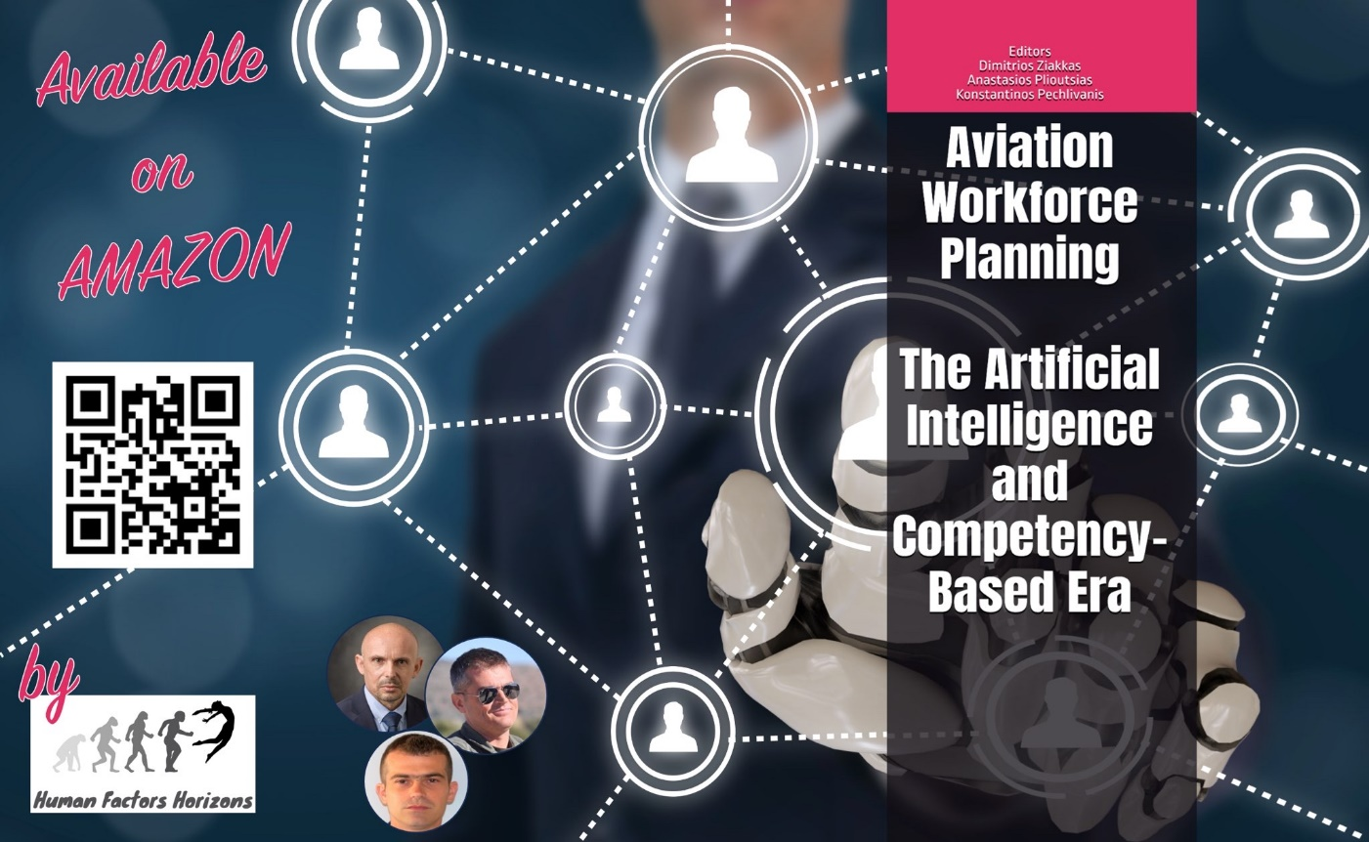
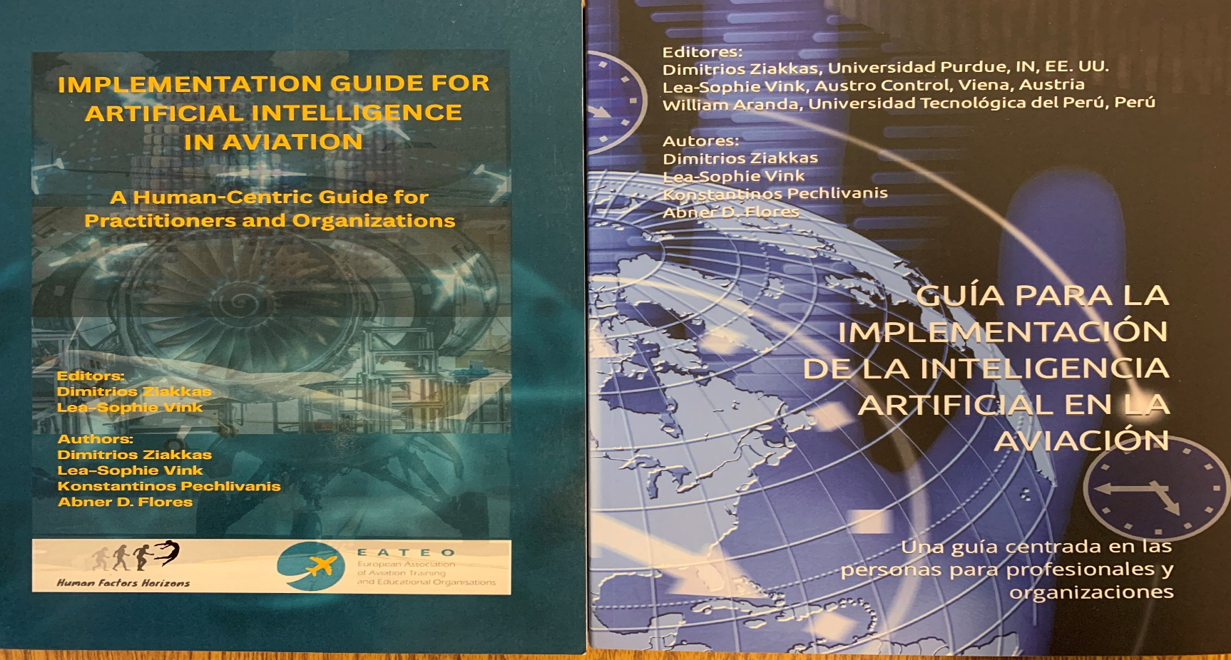
Questions
Many thanks to pilots who assisted with this work and our volunteers!

Slide 21
References
Li, L., Lv, Y., & Wang, F. Y. (2019). Traffic signal timing via deep reinforcement learning. *IEEE/CAA Journal of Automatica Sinica*, 6(3), 703-713. DOI
Osaba, E., Yang, X. S., Diaz, F., Onieva, E., Masegosa, A. D., & Perallos, A. (2017). A review on artificial intelligence in traffic management. *Transport*, 33(3), 711-725. DOI
Polson, N. G., & Sokolov, V. O. (2017). Deep learning for short-term traffic flow prediction. *Transportation Research Part C: Emerging Technologies*, 79, 1-17. DOI
Vlahogianni, E. I., Karlaftis, M. G., & Golias, J. C. (2014). Short-term traffic forecasting: Where we are and where we’re going. *Transportation Research Part C: Emerging Technologies*, 43, 3-19. DOI
Zhang, Y., & Haghani, A. (2015). A gradient boosting method to improve travel time prediction. *Transportation Research Part C: Emerging Technologies*, 58, 308-324. DOI
Ziakkas, D., Vink, L.-S., Pechlivanis, K., & Flores, A. (2023). Implementation Guide for Artificial Intelligence in Aviation: A Human-Centric Guide for Practitioners and Organizations. ISBN 9798863704784

Slide 22


